Slide 1
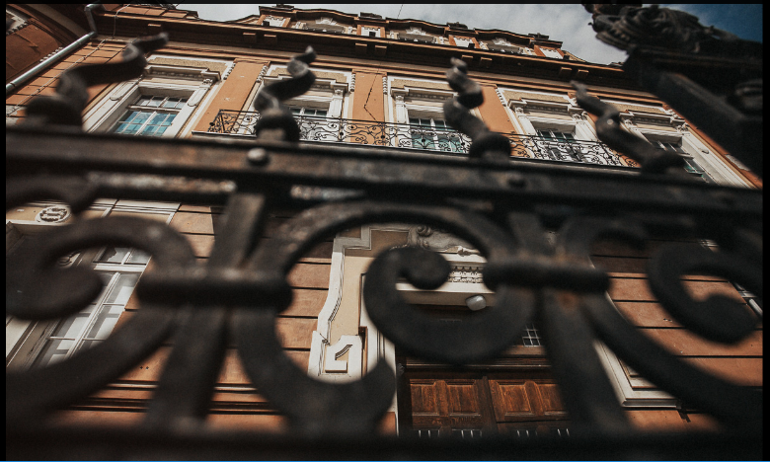
THEATRICAL LIFE OF OSIJEK: DIGITIZATION OF THE LOCAL AND MEMORIAL COLLECTIONS OF CITY AND UNIVERSITY LIBRARY OSIJEK
Ljiljana Krpeljević Svjetlana Mokriš Dubravka Pađen Farkaš

Slide 2
LOCAL COLLECTION
special separate collection of Study reading room department
Mursiana collection and Slavonica
printed books and other materials (monographies, periodicals and small print), manuscripts, grey literature, maps, music notations, audio, visual, audiovisual materials and preformatted materials
published in the local area, written by citizens born, having lived in and contributed to developement of Osijek-Baranja county, materials about local area published elsewhere in the world
mainly recent materials

Slide 3
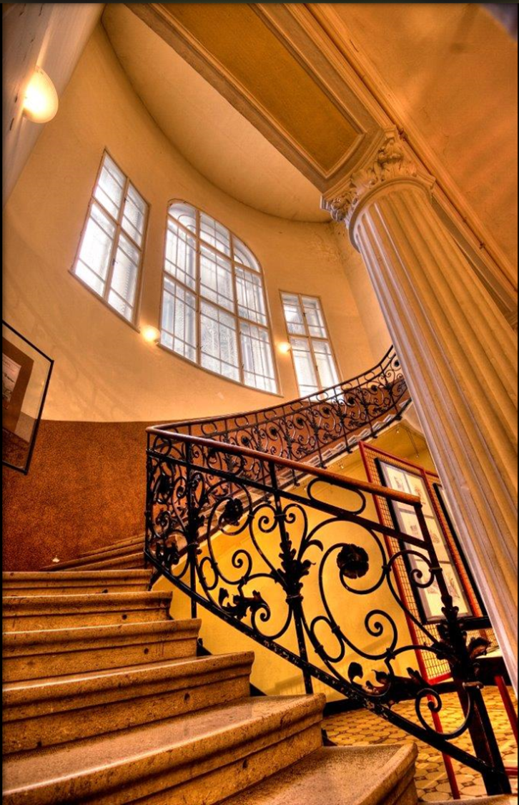
GOALS OF THE COLLECTION AND ITS SIGNIFANCE
starting point for different researches of the city and the region
professional and scientific activities in gathering, identifying and selection of materials concerning local history
assisting with marketing role of Local history collection
promotion of local authors and community in general through the Collection
preservation of cultural identity
creating informative aids
preservation of cultural identity

Slide 4
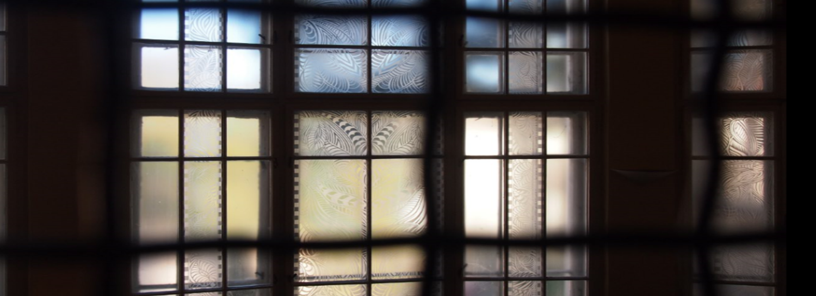
MEMORIAL COLLECTION
special collection within the Study reading room department
library materials published up to 1945, regardless of the place of publishing or printing
1949 - active creation of library collections has begun
sub-collections: books published up to 1945, Rare books collection, Divaldiana collection, Legacy collections (Hengl, Sonnenfeld, Pollak, Magjer, Rakoš, Pinterović, Kocijan)

Slide 5
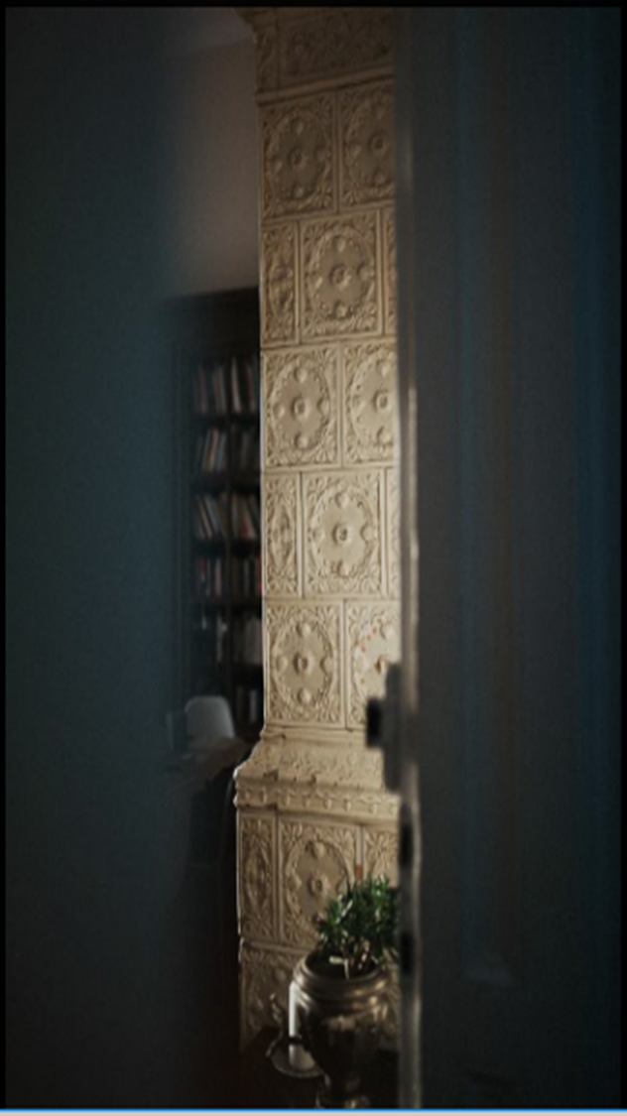
GOALS AND IMPORTANCE OF MEMORIAL COLLECTION
contributes to preservation of cultural heritage of Osijek, Slavonija region and Croatia
contributes to research of cultural and historic occasions, as well as the spirit of time in which the Library was formed
topic of research (book history, history of art, reading, printing)
basis for connecting dispersed library collections and heritage institutions through digitization
valuable museum artifact due to aesthetic and documentaristic value of the book

Slide 6
DIGITIZATION IN CROATIA
sporadic digitization of some valuable items till 2006
national programme initiated by the Ministry of Culture in 2006
portal Croatian Cultural Heritage
institutions involved in the project - select the material, prepare it for digitization, i.e. check completeness, do repairs if needed, add metadata, provide names of datafiles, etc.
technical part of the process - professional firms, departments of the institutions themselves

Slide 7
DIGITIZED LOCAL COLLECTION OF THE
CITY AND UNIVERSITY LIBRARY OSIJEK
digitization of libray collection was started in 2008
protecting the original of documents, enabling access to documents, creating new products and services and completing the collections
local periodicals, local monographies, postcards of Osijek, catalogs, graphics, photos, maps, literary heritage of Rudolf Franjin Magjer
available at: Library home page (http://www.gskos.unios.hr/), on an electronic portal Croatian Cultural Heritage ((http://www.kultura.hr)

Slide 8
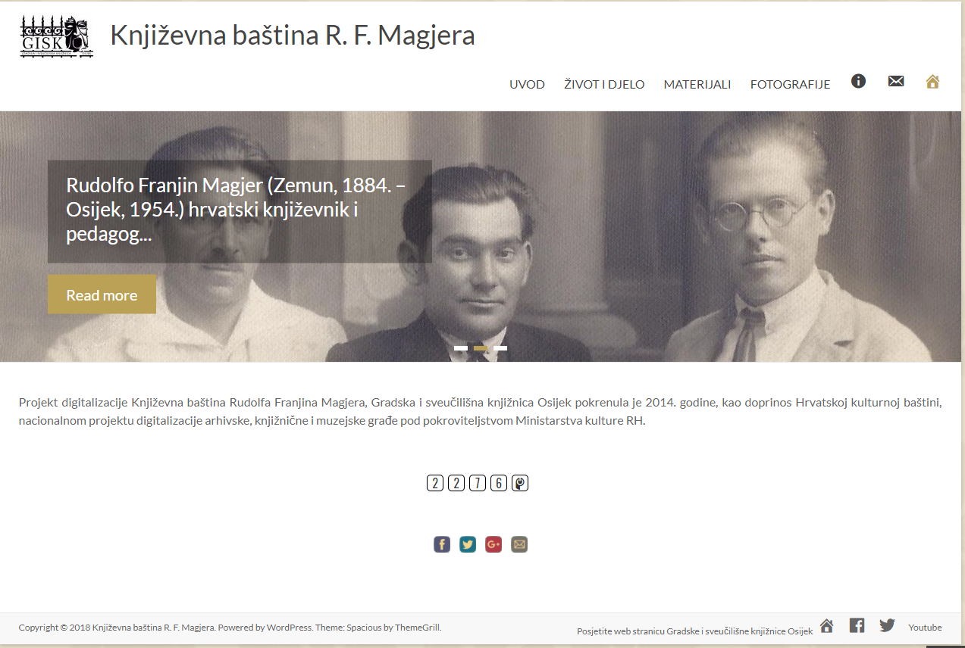
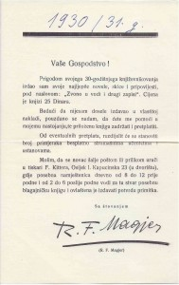
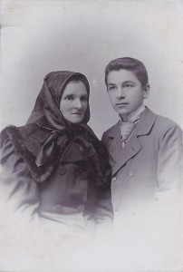
WHAT DID WE DIGITIZE SO FAR
volume (page)
Rare books | 1 (385)
Books | 45 (2.602)
Newspapers | 300 (9.700)
Serials | 409 (6.611)
Manuscripts | 13
Maps | 12
Photos | 96
Engravings | 7 (77)
Posters | 228
Postcards | 105
Other: Small print | 7

Slide 9
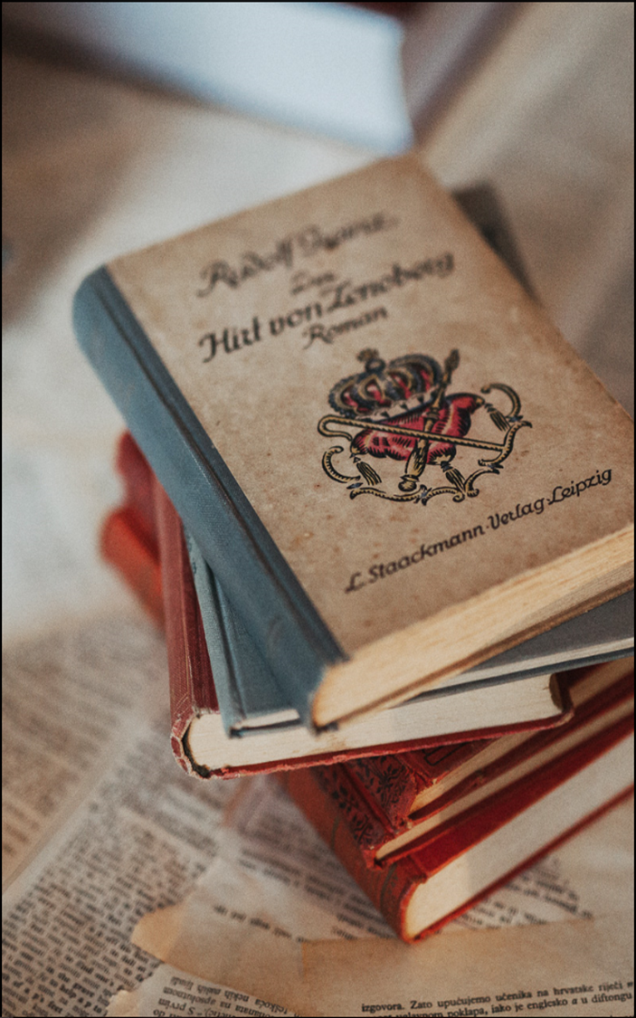
WHAT ARE WE PLANING TO DIGITIZE
volume (page)
Rare books | 15 (5863)
Other books | 55 (6.967)
Newspapers | 19.600 (623.900)
Serials | 3 (258)
Photos | 50
Posters | 50
Other: Small print | 100

Slide 10
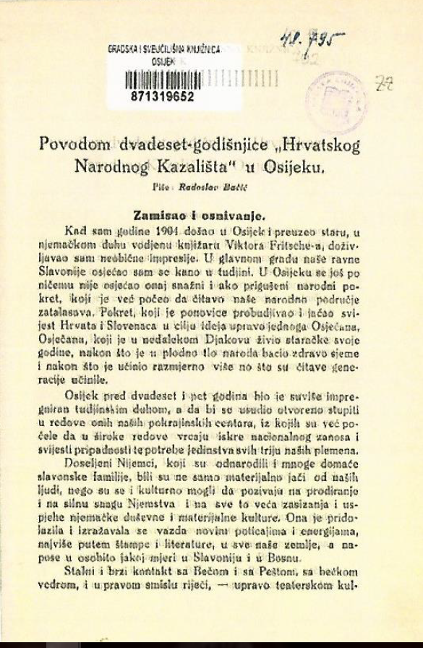
MATERIALS ABOUT CROATIAN NATIONAL THEATRE IN OSIJEK IN GISKO
Croatian National Theatre in Osijek was founded in 1907
second professional theatre in Croatia
materials about Croatian National Theatre in Osijek in Library: journals Osječka pozornica and Kazalište, programs and posters
covers a period from the beginning of 20th century up to the present

Slide 11
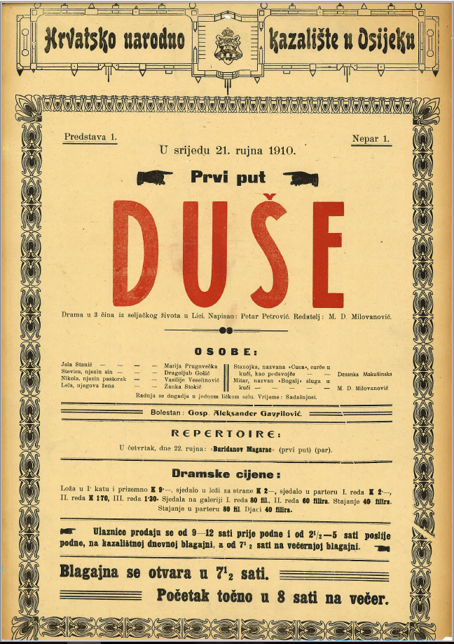
COOPERATION WITH ARCANUM DIGITHECA (ADT)
a large part of planned digitization of materials about Croatian National Theatre in Osijek was done during 2017
technical part of the process - done by professional firm Arcanum Digithec (ADT)
small part - digitized in the Library
total of 3500 pages
metadata will be added in the Library
materials will be published at the Library website till the end of 2018

Slide 12
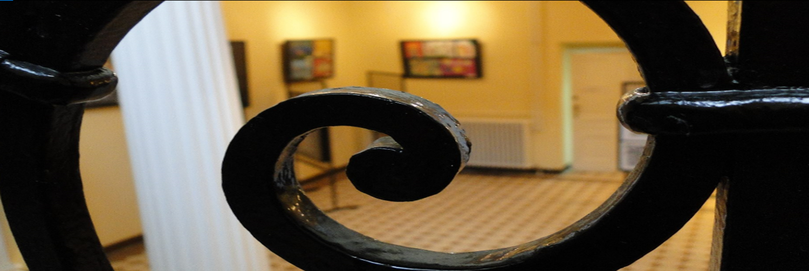
”LOCAL HISTORY STORIES“
introducing the collection to wider audiences during the ”Croatian book month 2018”
”Theatrical life of Osijek“ - new exhibition in the cycle of exhibits called ”Local history stories“
promoting Local collection and turning attention towards individuals and institutions who put Osijek on the cultural and scientific map of Croatia

Slide 13
Thank you!
background music:
Franjo Krežma - Evening song (Violin and String Quartet)
Franjo Krežma (2 September 1862 – 15 June 1881) was a Croatian violinist and composer born in Osijek.

